Slide 1



Analytical Insights
Samuel Emehi

Slide 2
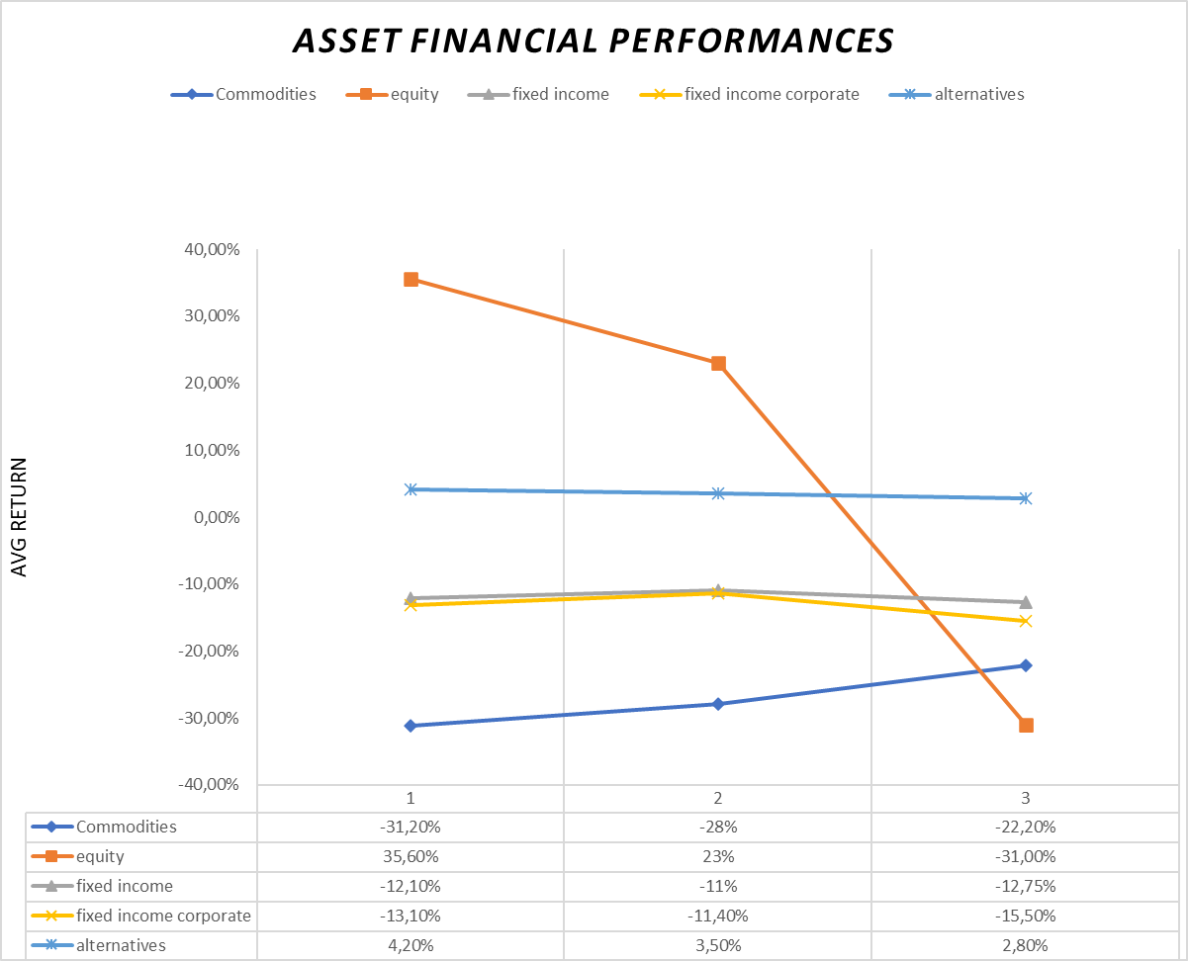

Portfolio Analysis
Asset Class

Slide 3

Asset Class Insights
1 | Commodities | 2 | Equity
 | There is a decrease in negative returns during the two-year period under consideration. Inversely correlated with Equity. |  | Analyses show a steep descent during the two-year period under consideration
3 | Fixed Income
 | Negative performance during the period considered, despite reduced riskiness compared to the other assets considered. |  | Performed positively, reporting a + sign on returns. Despite witnessing a decrescent during the period considered.
3 | Fixed Income
4 | Alternatives

Slide 4
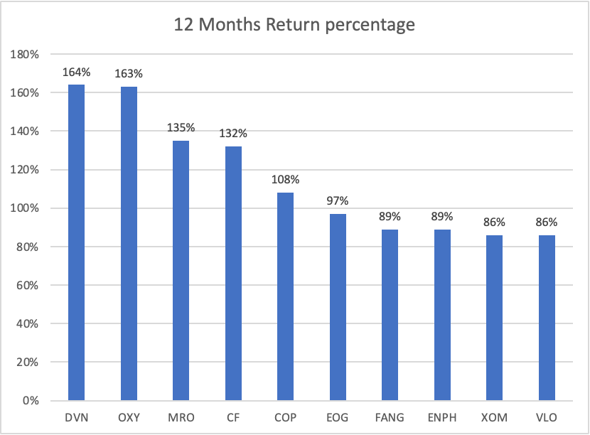

Top 10 Performing Tickers
Outcome
The asset class of top 10 high returns were equity.
Majority of the security is related to energy.
DVN
OXY
MRO
CF
COP
EOG
FANG
ENPH
XOM
VLO
Devon Energy Corporation
Occidental Petroleum Corporation
Marathon Oil Corporation
CF Industries Holdings Inc.
ConocoPhilips
EOG Resources Inc.
Diamondback Energy Inc.
Enphase Energy Inc.
Exxon Mobil Corporation
Valero Energy Corporation

Slide 5
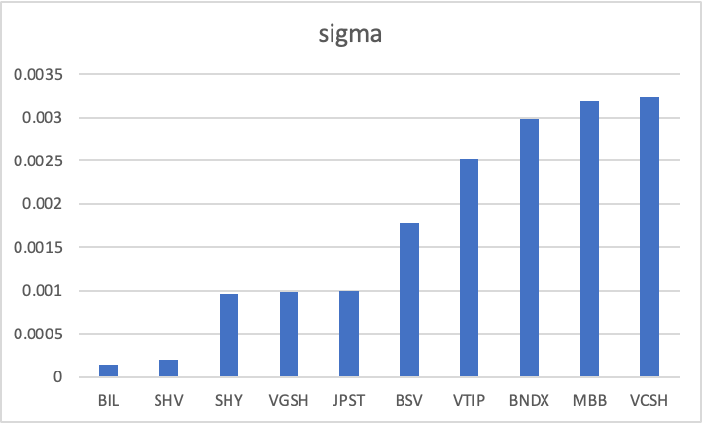
Top 10 Risky Tickers
Outcome
The asset class of top 10 riskiest tickers were all fixed income.
Majority of the security is related to short-term investments.
BIL
SHV
SHY
VGSH
JPST
BSV
VTIP
BNDX
MBB
VCSH
SPDR Bloomberg 1-3 Month T-Bill ETF
iShares Short Treasury Bond ETF
iShares 1-3 Year Treasury Bond ETF
Vanguard Short-Term Treasury ETF
JPMorgan Ultra-Short Income ETF
Vanguard Short-Term Bond ETF
Vanguard Short-Term Inflation-Protected Securities ETF
Vanguard Total International Bond ETF
iShares MBS ETF
Vanguard Short-Term Corporate Bond ETF

Slide 6



Analytical Insights
Asset Correlation Analysis
Portfolio Analysis

Slide 7

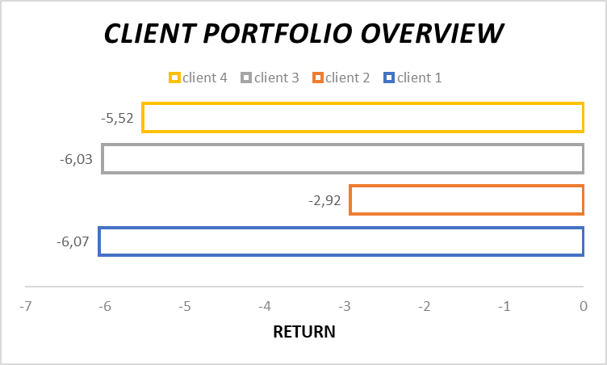
Client Portfolio

Slide 8
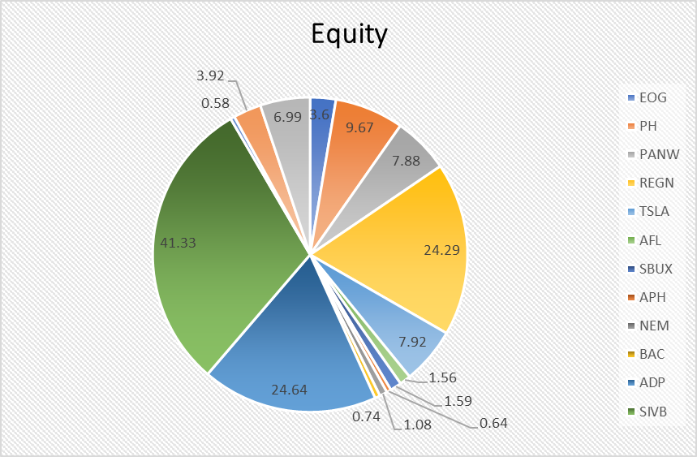
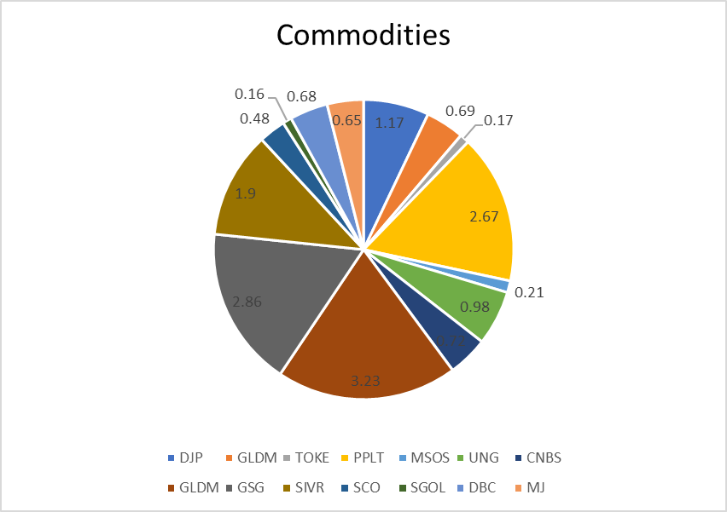
Client: Daisuke Kitaguchi

Slide 9
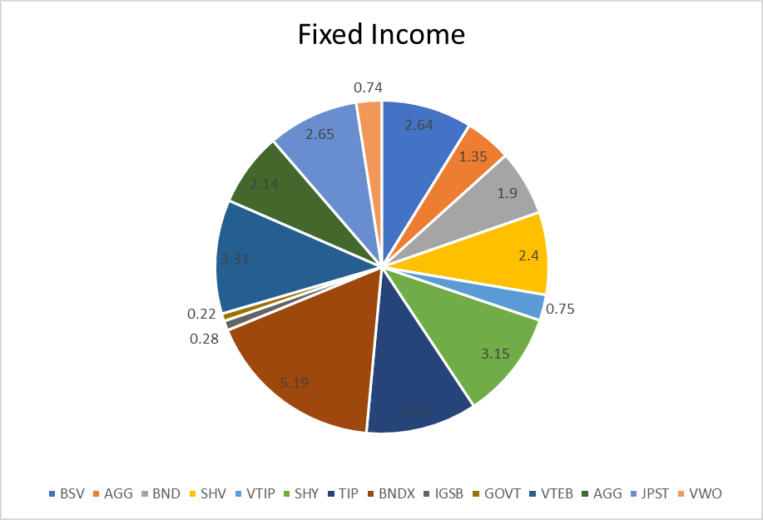
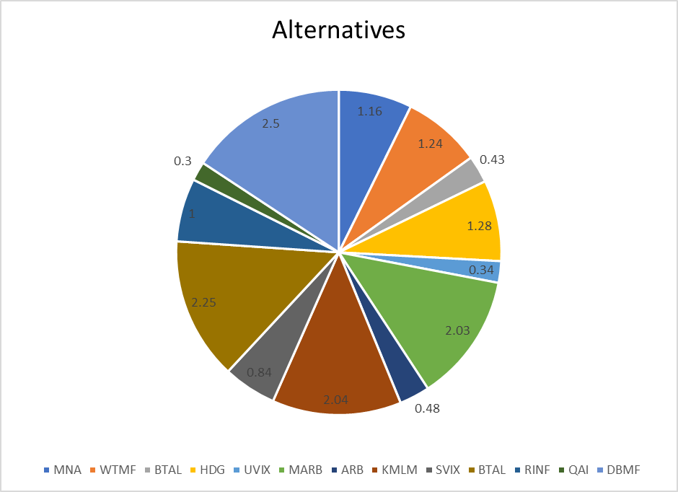
Client: Daisuke Kitaguchi

Slide 10

Asset Class
Correlation Analysis
Correlation | equity | commodities | fixed_income | alternatives
equity | 1
commodities | -0.623630531 | 1
fixed_income | 0.938796652 | -0.705494472 | 1
alternatives | -0.905605471 | 0.825760736 | -0.922838189 | 1

Slide 11
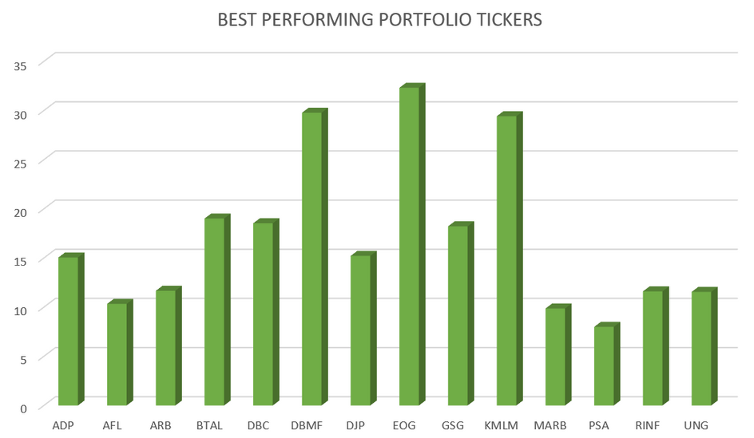
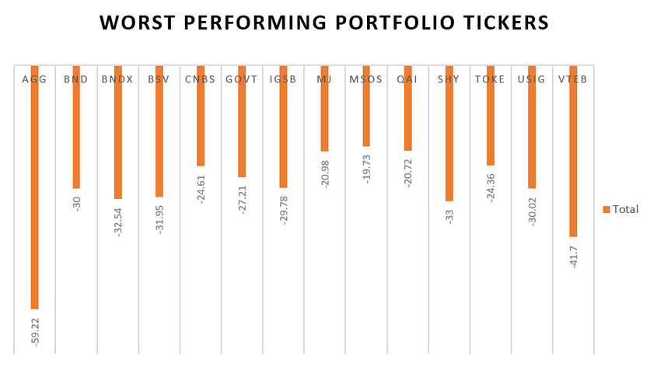
Recommendation for
the Client
WHERE WE WANT TO FOCUS ON
Avoid the the worst 3 performing tickers and accept the best performing portfolio in investment decision making
Invest in inversely correlated assets so that we can reduce the chance of risk. These groups are equity & commodity, fixed income & commodity, equity & alternatives.

Slide 12
THANK YOU

